Slide 1
Security
Overview of Cryptographic Techniques

Slide 2
Some Basic Terminology
plaintext - original message
ciphertext - coded message
cipher - algorithm for transforming plaintext to ciphertext
key - info used in cipher known only to sender/receiver
encipher (encrypt) - converting plaintext to ciphertext
decipher (decrypt) - recovering ciphertext from plaintext
cryptography - study of encryption principles/methods
cryptanalysis (codebreaking) - study of principles/ methods of deciphering ciphertext without knowing key
cryptology - field of both cryptography and cryptanalysis

Slide 3



Types of Attacks
Ciphertext Only – adversary uses just the ciphertext to gain either the key or the plaintext (really bad encryption)
Known Plaintext – adversary gets the key using some ciphertext and its plaintext
Chosen Plaintext – adversary introduces some plaintext to generate some ciphertext

Slide 4
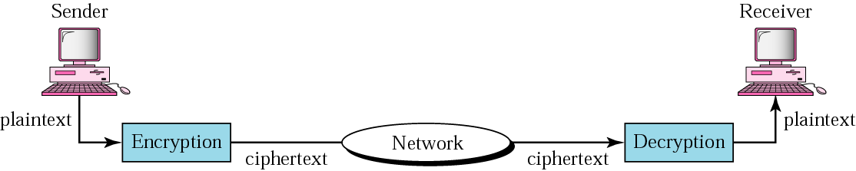
Cryptography components

Slide 5




Conventional Encryption Principles
An encryption scheme has five ingredients:
Plaintext
Encryption algorithm
Secret Key
Ciphertext
Decryption algorithm
Security depends on the secrecy of the key, not the secrecy of the algorithm

Slide 6
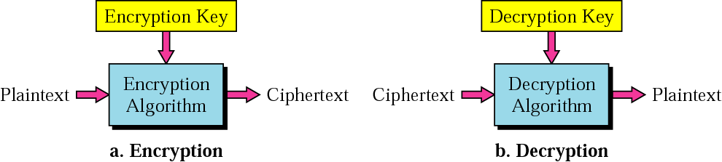
Encryption and decryption

Slide 7



Characteristics of Cryptographic Techniques
Classified along three independent dimensions:
The type of operations used for transforming plaintext to ciphertext
The number of keys used
symmetric (single key)
asymmetric (two-keys, or public-key encryption)
The way in which the plaintext is processed

Slide 8
Symmetric Encryption
conventional / private-key / single-key
sender and recipient share a common key
all classical encryption algorithms are private-key
was only type prior to invention of public-key in 1970’s and by far most widely used

Slide 9
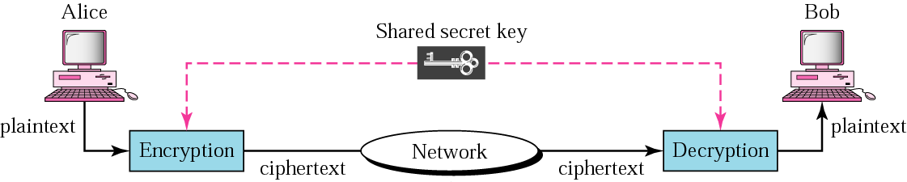
Symmetric-key cryptography

Slide 10
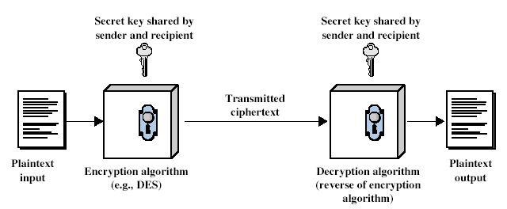
Symmetric Cipher Model

Slide 11
Two requirements for secure use of symmetric encryption:
a strong encryption algorithm
a secret key known only to sender / receiver
mathematically have:
Y = E_{K}(X) [= E(K, X) ]
X = D_{K}(Y) [= D(K, Y) ]
assume encryption algorithm is known
implies a secure channel to distribute key

Slide 12
Classical Substitution Ciphers
where letters of plaintext are replaced by other letters or by numbers or symbols
or if plaintext is viewed as a sequence of bits, then substitution involves replacing plaintext bit patterns with ciphertext bit patterns

Slide 13
Caesar Cipher –Shift Cipher
earliest known substitution cipher
by Julius Caesar
first attested use in military affairs
replaces each letter by 3rd letter after
example:
meet me after the party
PHHW PH DIWHU WKH SDUWB
Caesar cipher as:
c = E(p) = (p + k) mod (26)
p = D(c) = (c – k) mod (26)

Slide 14
Monoalphabetic Cipher
rather than just shifting the alphabet
could shuffle (jumble) the letters arbitrarily
each plaintext letter maps to a different random ciphertext letter
hence key is 26 letters long
Plain: abcdefghijklmnopqrstuvwxyz
Cipher: DKVQFIBJWPESCXHTMYAUOLRGZN
Plaintext: ifwewishtoreplaceletters
Ciphertext: WIRFRWAJUHYFTSDVFSFUUFYA

Slide 15
In monoalphabetic substitution, the relationship between a character in the plaintext to the character in the ciphertext is always one-to-one.

Slide 16
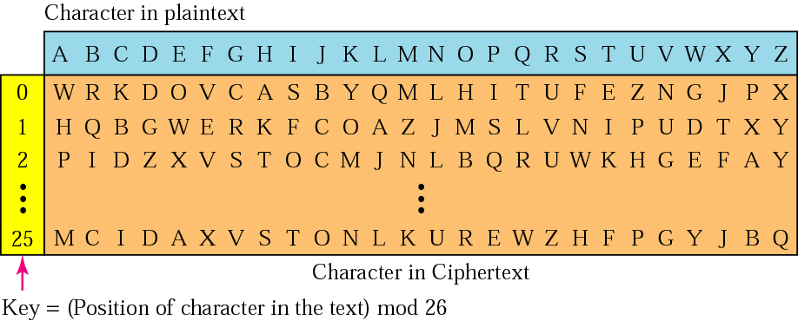
Vigenere cipher

Slide 17
Polyalphabetic Ciphers
polyalphabetic substitution ciphers
A set of related monoalphabetic substitution rules is used
use a key to select which alphabet is used for each letter of the message
use each alphabet in turn
repeat from start after end of key is reached
make cryptanalysis harder with more alphabets to guess and flatter frequency distribution
Key: deceptive 3 4 2 4 15 19 8 21 4
plaintext: wireless 22 8 17 4 11 4 18 18
ciphertext: zmtiaxao 25 12 19 8 26 23 26 39

Slide 18
In polyalphabetic substitution, the relationship between a character in the plaintext and a character in the ciphertext is one-to-many.

Slide 19
Transposition Cipher
Mapping is performed by some sort of permutation on the plaintext letters.
Example: Rail fence of depth 2
text : meet me after the party
m e m a t r h p r y
e t e f e t e a t
cipher: MEMATRHPRYETEFETEAT
Rail fence of depth 2

Slide 20
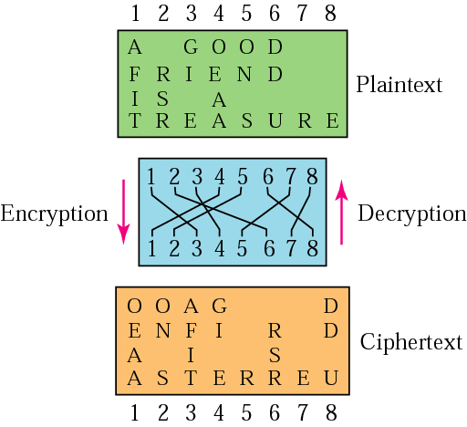
Transpositional cipher

Slide 21
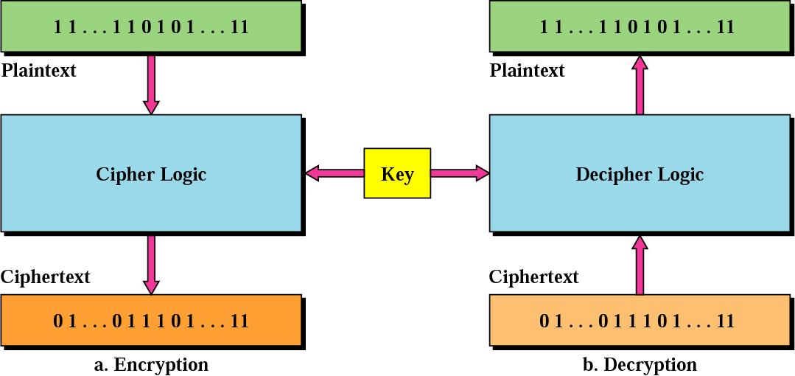
Modern Block Ciphers
Block cipher

Slide 22
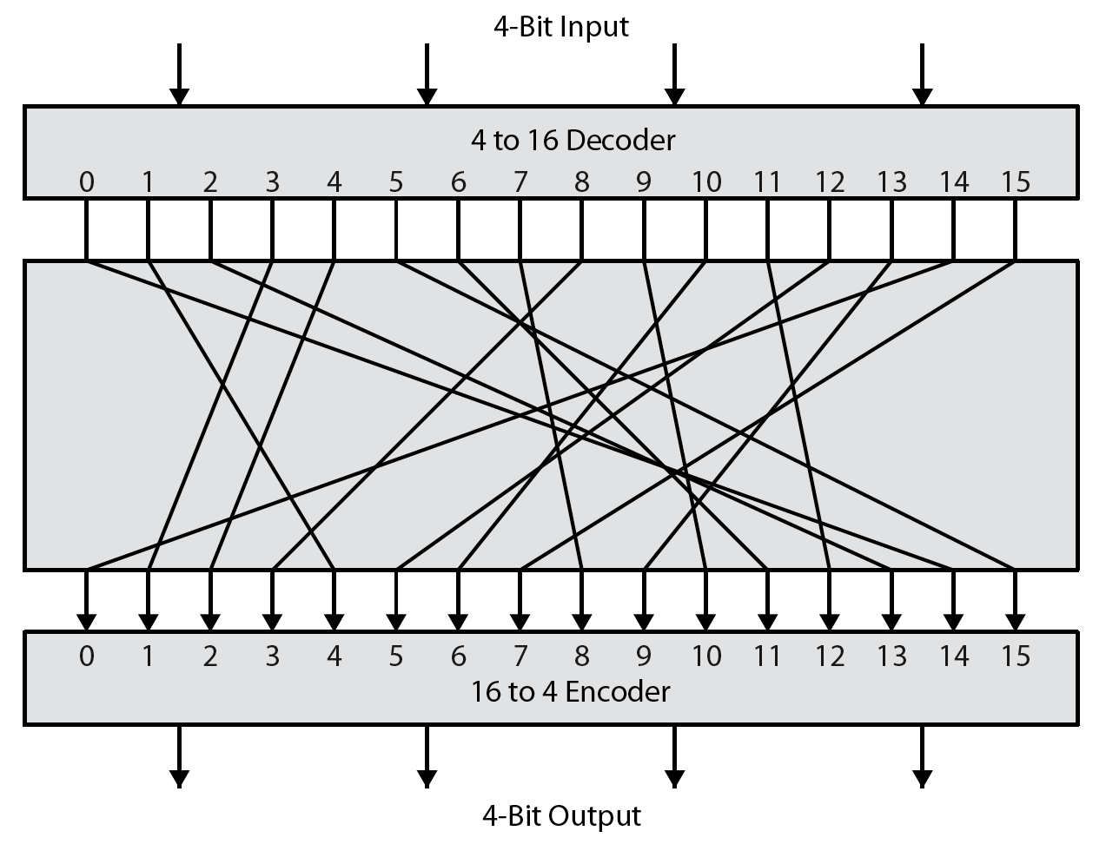
Ideal Block Cipher
Notes:
Feistel refers to an n-bit general substitution as an ideal block cipher, because it allows for the maximum number of possible encryption mappings from the plaintext to ciphertext block. A 4-bit input produces one of 16 possible input states, which is mapped by the substitution cipher into a unique one of 16 possible output states, each of which is represented by 4 ciphertext bits. The encryption and decryption mappings can be defined by a tabulation, as shown in Stallings Figure 3.1. It illustrates a tiny 4-bit substitution to show that each possible input can be arbitrarily mapped to any output - which is why its complexity grows so rapidly.

Slide 23
Block vs Stream Ciphers
block ciphers process messages in blocks, each of which is then en/decrypted
like a substitution on very big characters
64-bits or more
stream ciphers process messages a bit or byte at a time when en/decrypting
many current ciphers are block ciphers
broader range of applications
Notes:
Block ciphers work a on block / word at a time, which is some number of bits. All of these bits have to be available before the block can be processed. Stream ciphers work on a bit or byte of the message at a time, hence process it as a “stream”. Block ciphers are currently better analysed, and seem to have a broader range of applications, hence focus on them.

Slide 24
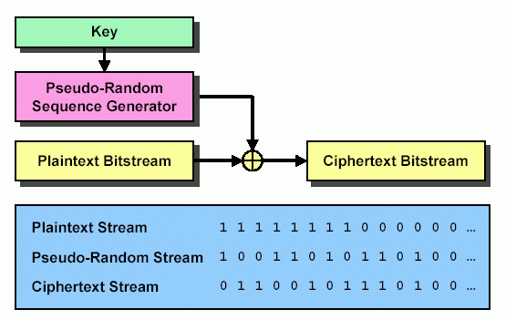



Stream Cipher
Stream ciphers
Rather than divide bit stream into discrete blocks, as block ciphers do, XOR each bit of your plaintext continuous stream with a bit from a pseudo-random sequence
At receiver, use same symmetric key, XOR again to extract plaintext

Slide 25
DES Design Principles
Confusion – complicate the relationship between key and ciphertext
Modern substitution ciphers take in N bits and substitute N bits using lookup table: called S-Boxes
Diffusion – spread structure of plaintext around the ciphertext
Modern Transposition ciphers take in N bits and permute using lookup table : called P-Boxes

Slide 26
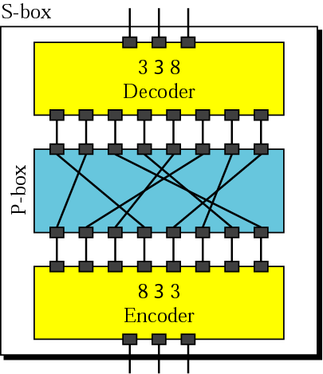
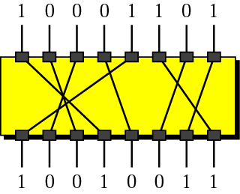
P -Box

Slide 27
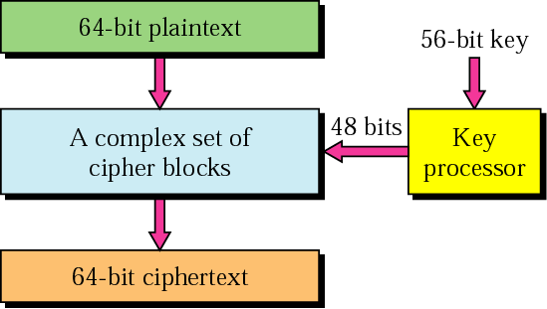
DES

Slide 28
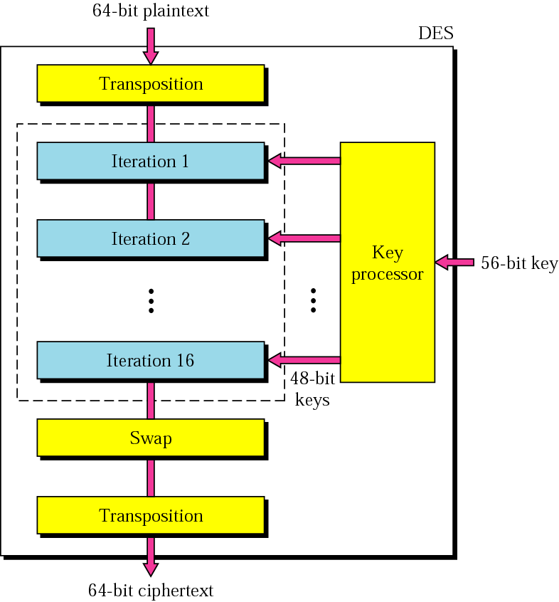
General scheme of DES

Slide 29
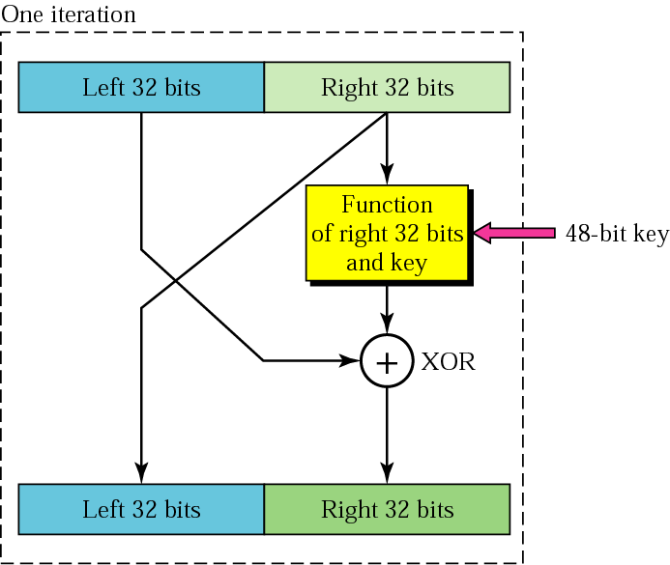
Iteration block

Slide 30
Public Key Encryption
Two Keys : encryption and decryption
Encryption key is public
Decryption key is private
Once sender encrypts a message, even they can’t decrypt it

Slide 31
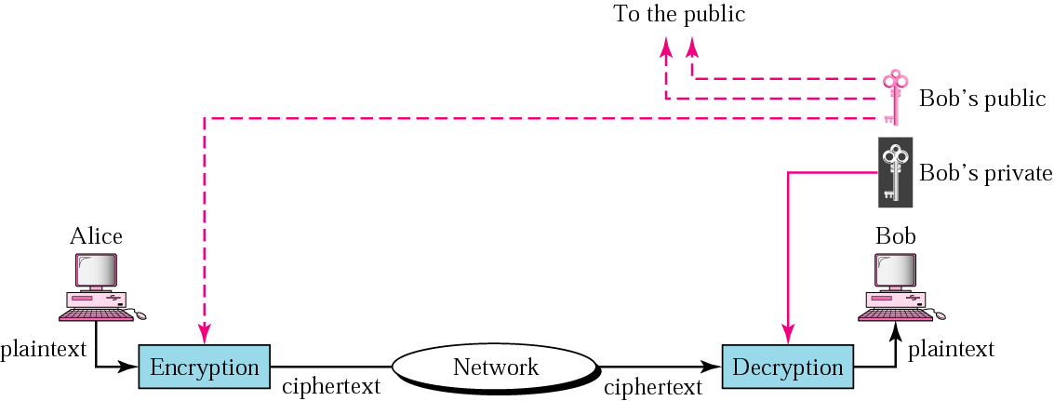
Public-key cryptography

Slide 32
Public Key Encryption
Receiver sends their public key to the sender
Sender encrypts message using that public key
Sender sends encrypted message
Receiver decrypts message using their private key

